Slide 1

USA Healthcare & Covid-19
The Fractured State
-Alisha Warke

Slide 2


Slide 3

"Why do people die vs others that don’t of Covid-19?”
Regional Differences?
Republican States Vs Democratic States?
Lack of Hospitals in some states?
Rural areas impacted?
Age Group (seniors) & Ethnic Groups?
Demographics difference (Age, Sex, Race)
Socio-Economics
Quality of care provided
Income Inequality

Slide 4

US census data It includes data from the entire country. The data here were collected by the US Census Bureau and includes detail such as demographic characteristics, population, race, profession, sex, poverty, etc. Death Counts for Coronavirus Disease (COVID-19) This dataset by CDC shows the Age group, Sex, Covid-19 deaths Also contains data of deaths by influenza and pneumonia to provide context for understanding the completeness of COVID-19 mortality data and related trends Hospital capacity Has data of adult population, no. of beds in hospitals, no. of ICU beds, Occupancy rate, etc. Healthcare quality Shows quality of healthcare on the scale of 0-100 for each
Datasets Used

Slide 5
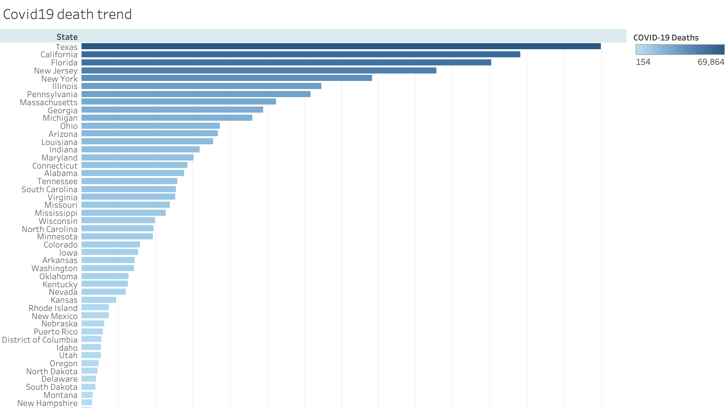

Covid-19 Death Trend

Slide 6

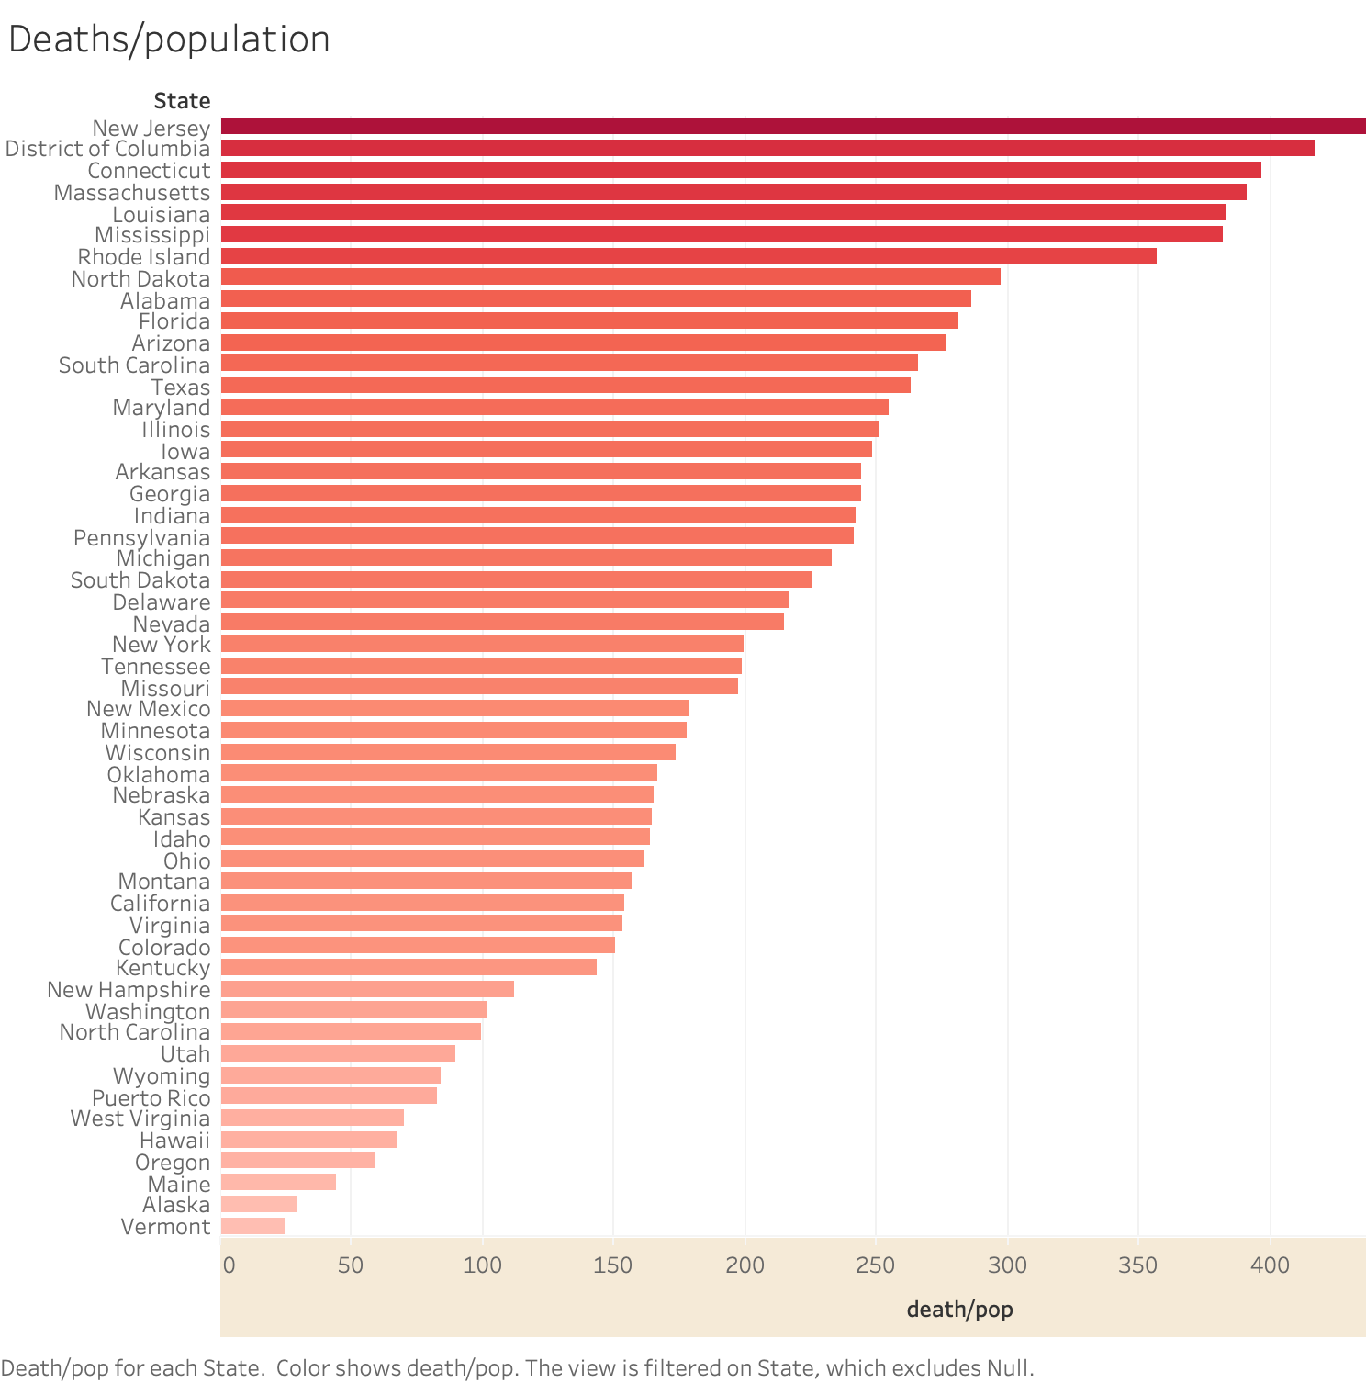

Slide 7
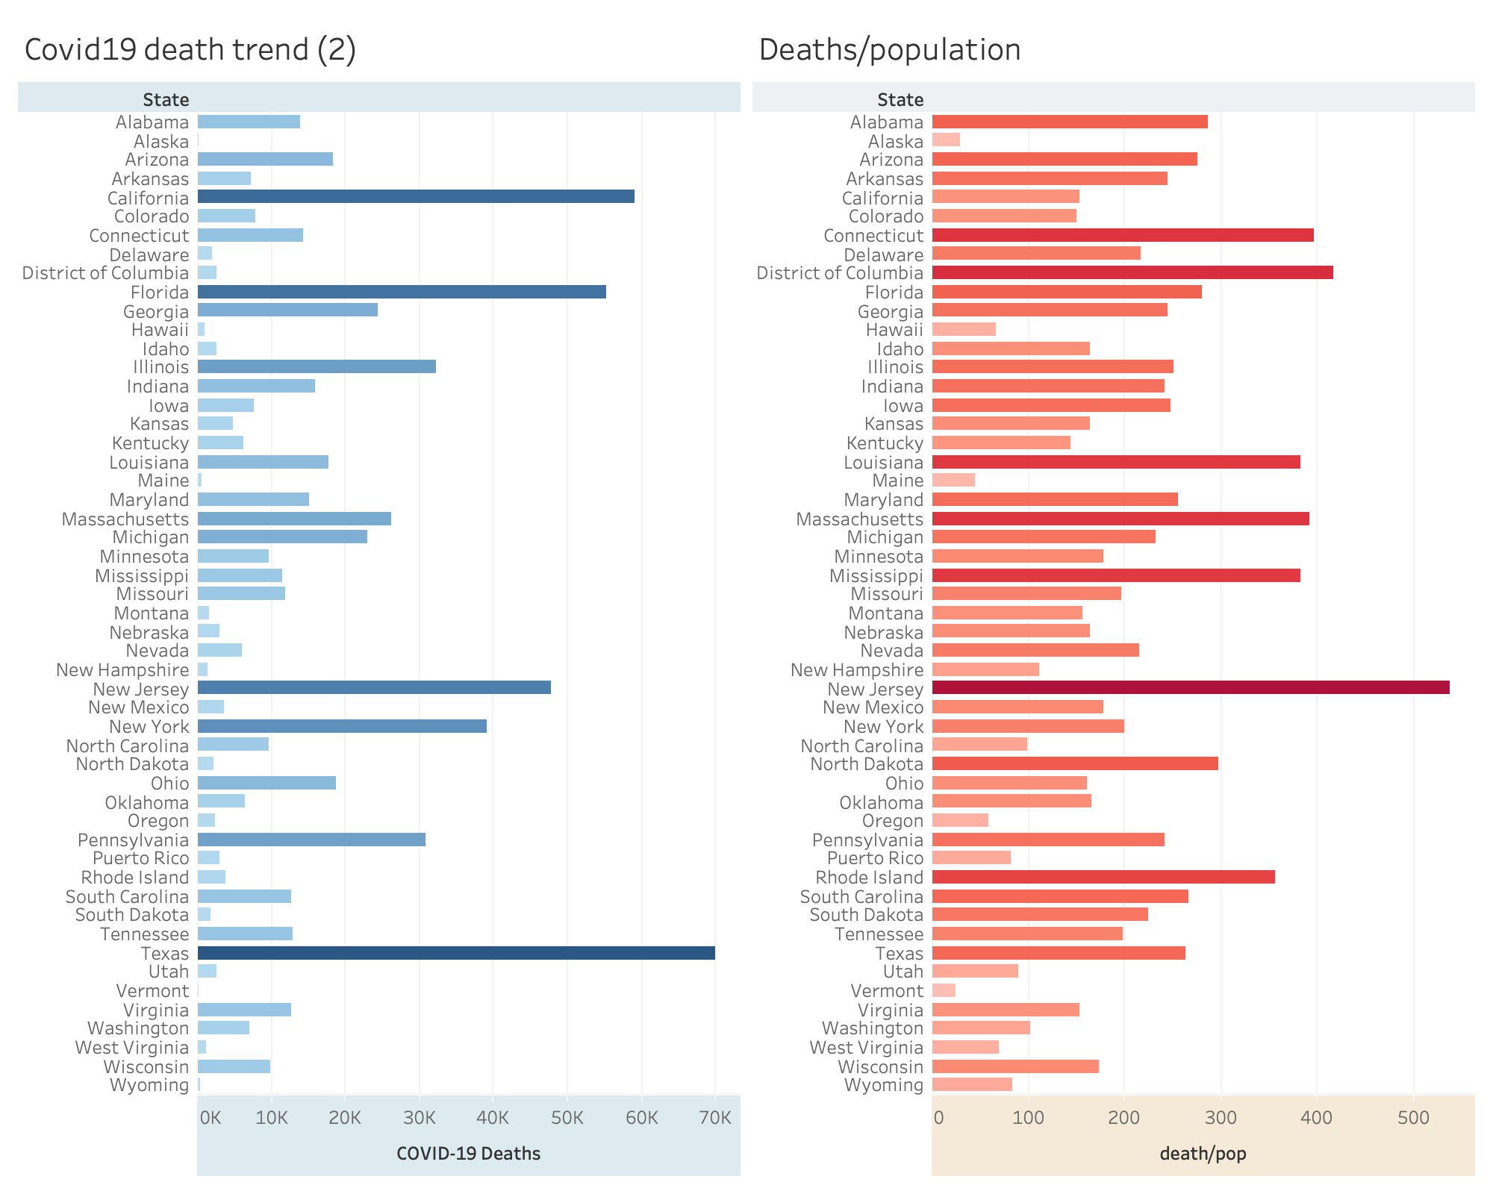


Slide 8

8 Out of 10 covid-19 deaths reported in the U.S. have been in adults 65 years and older

Slide 9
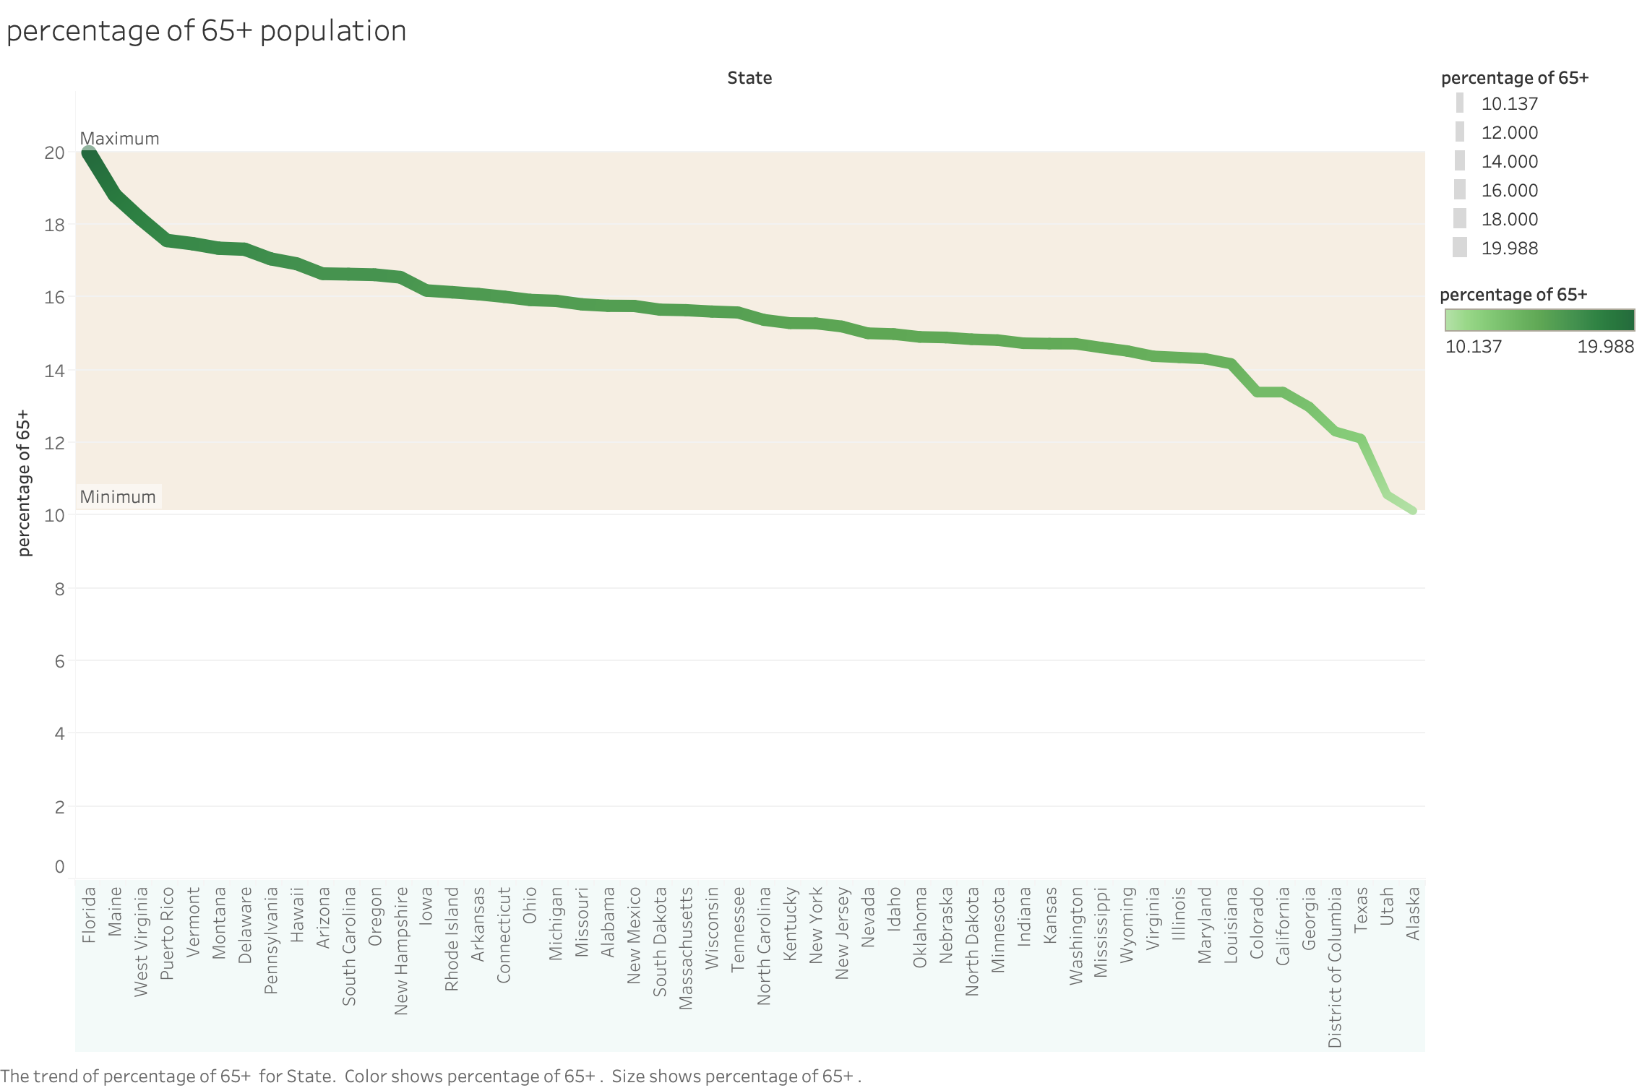


Slide 10
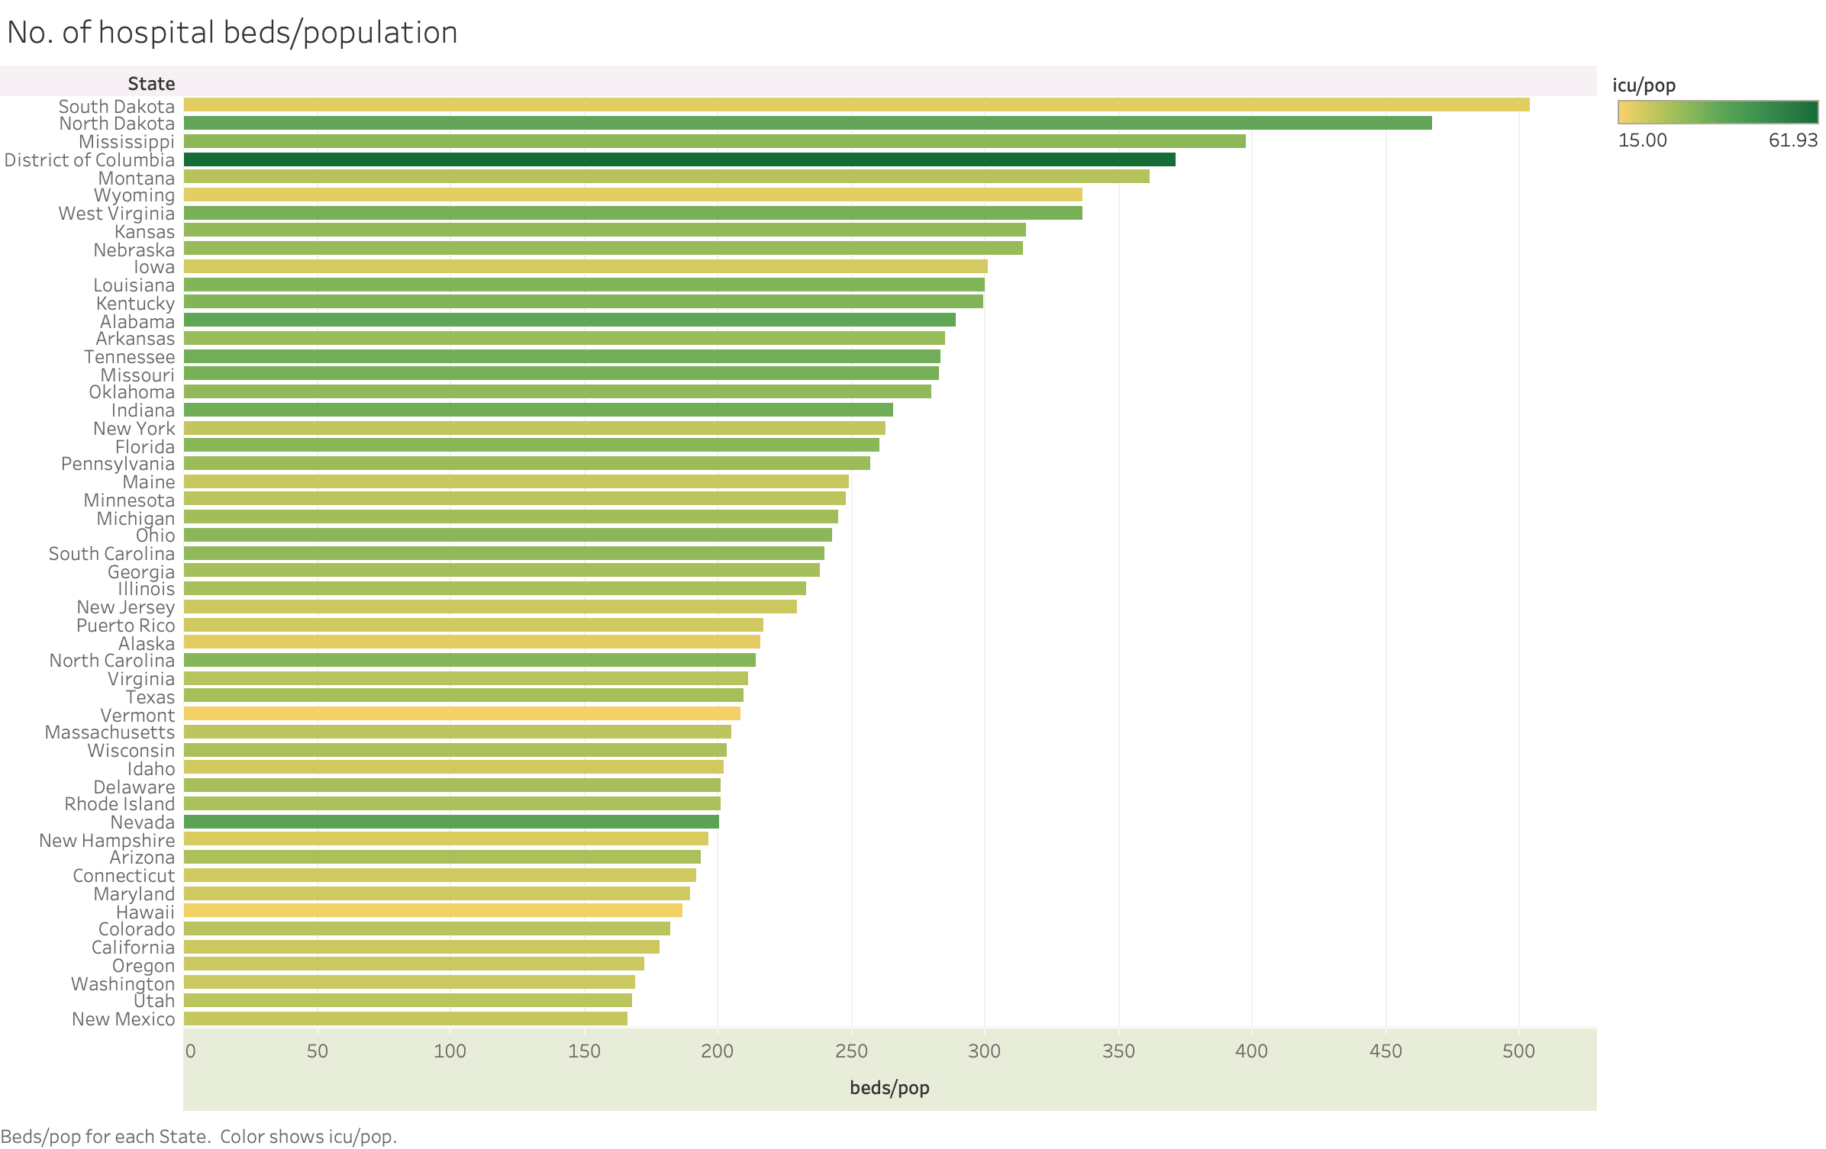


Slide 11
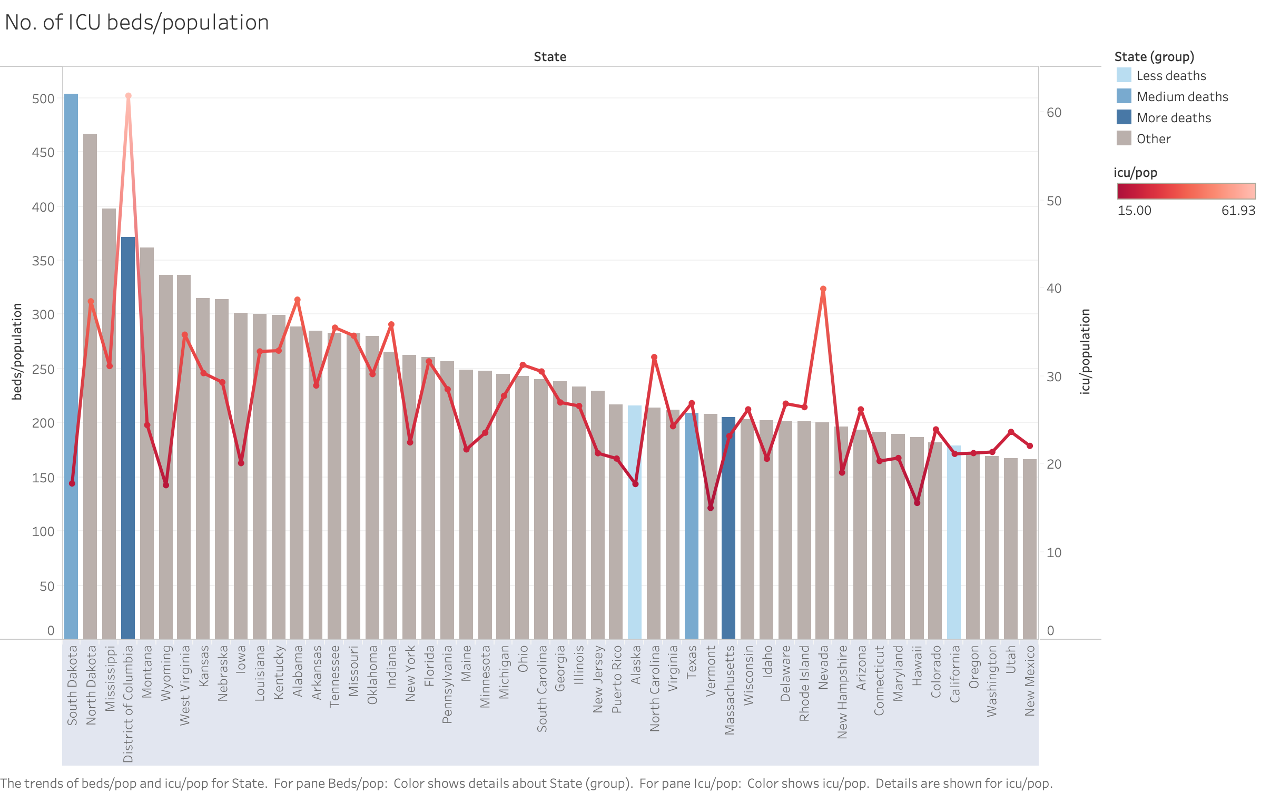

No. Of ICU/Population

Slide 12

Does Socio-Economic Play a role?

Slide 13
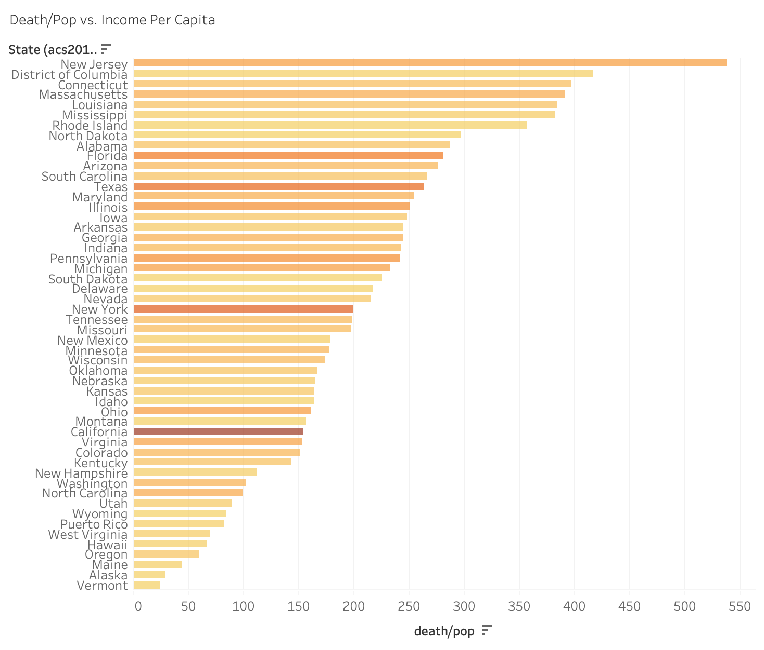




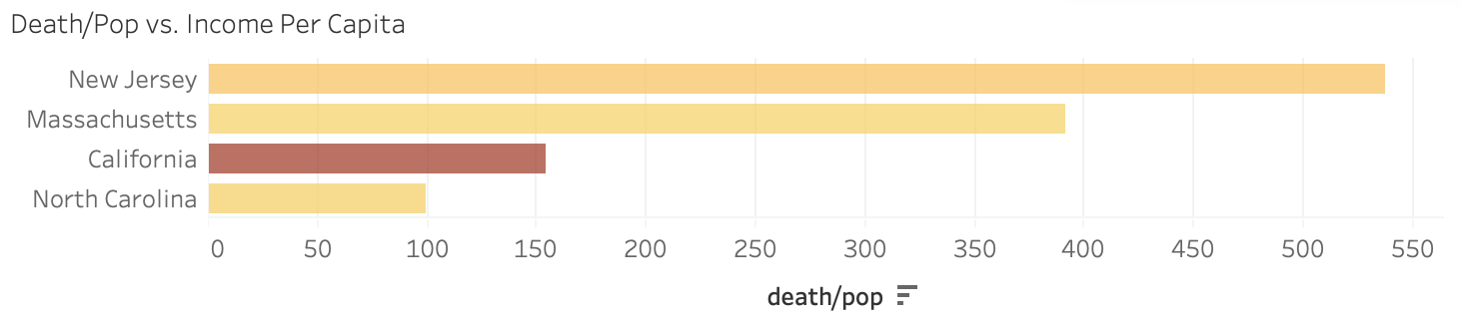




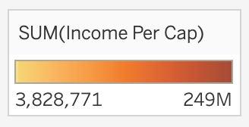

Slide 14

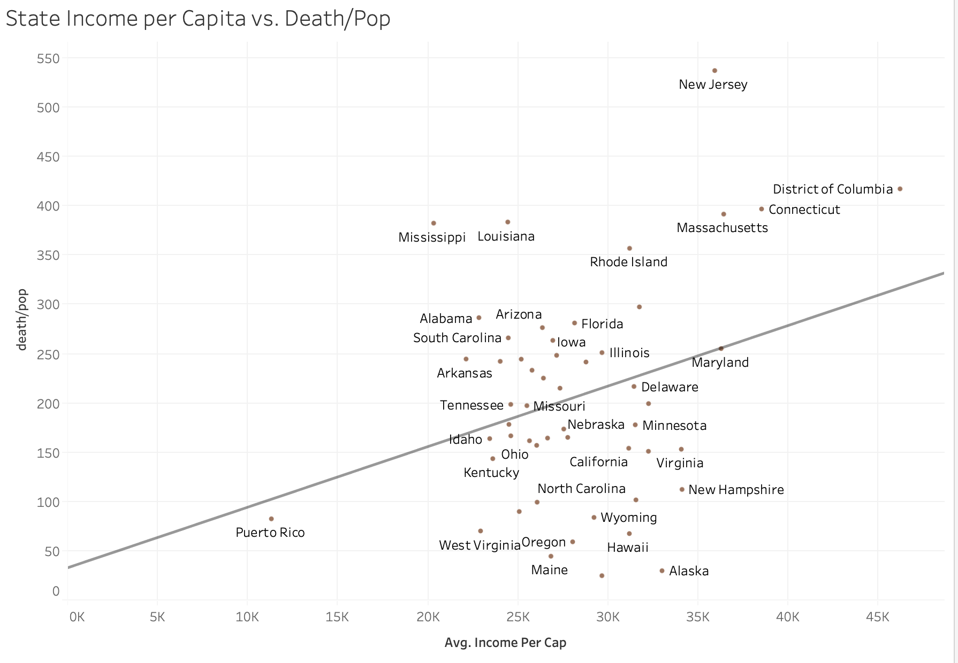

Slide 15
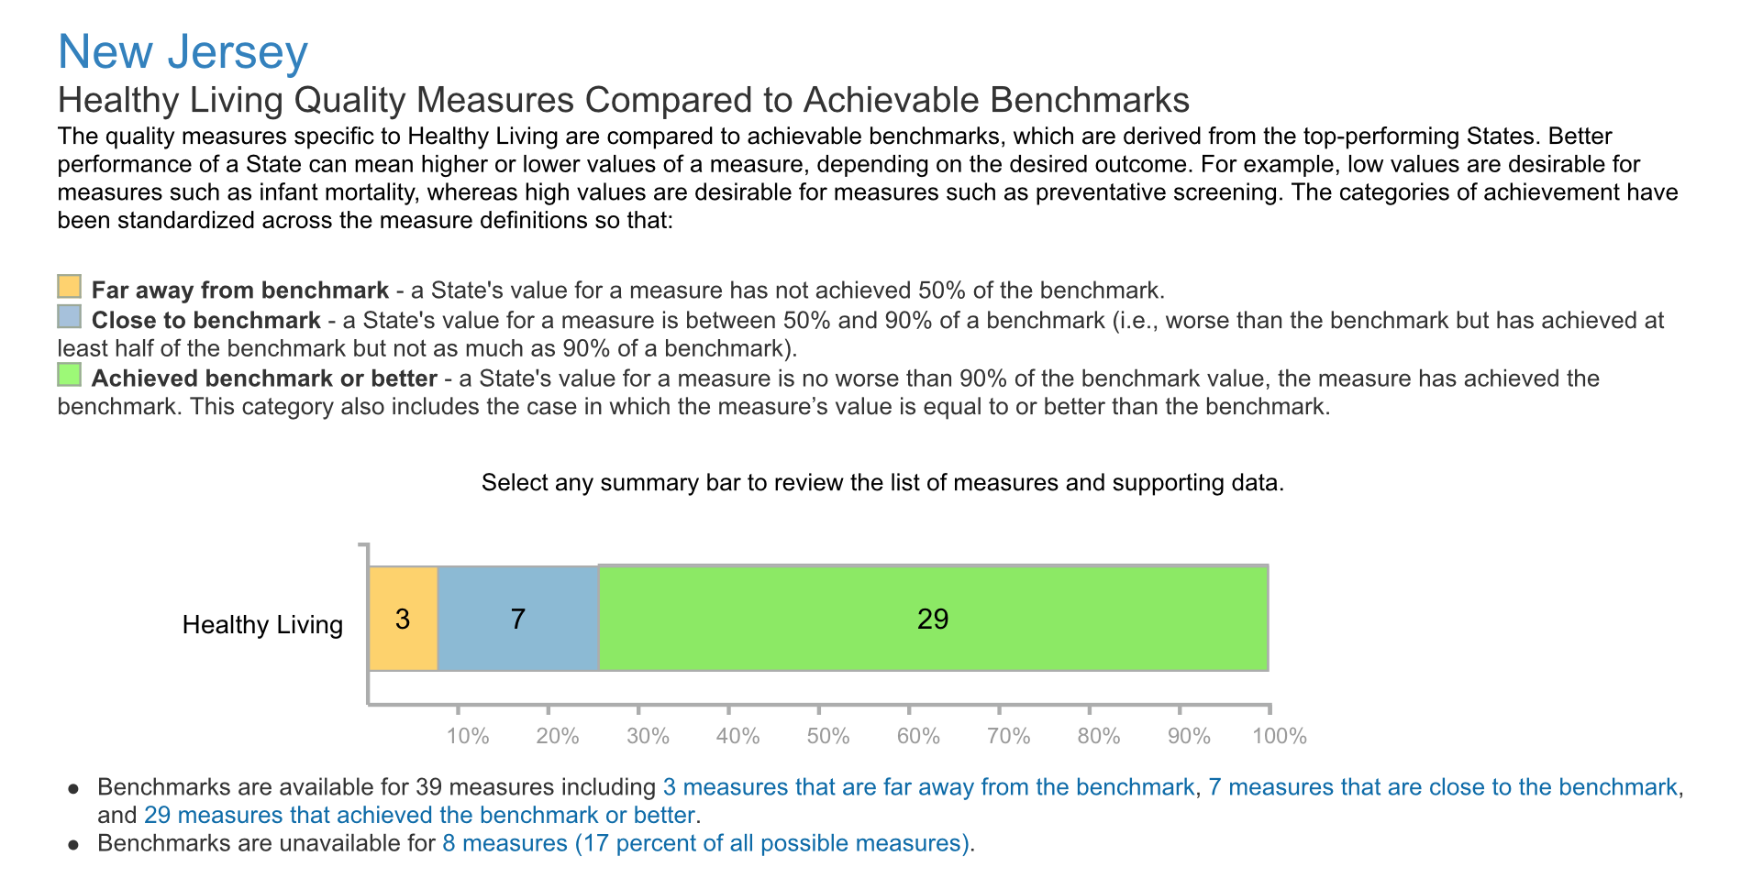
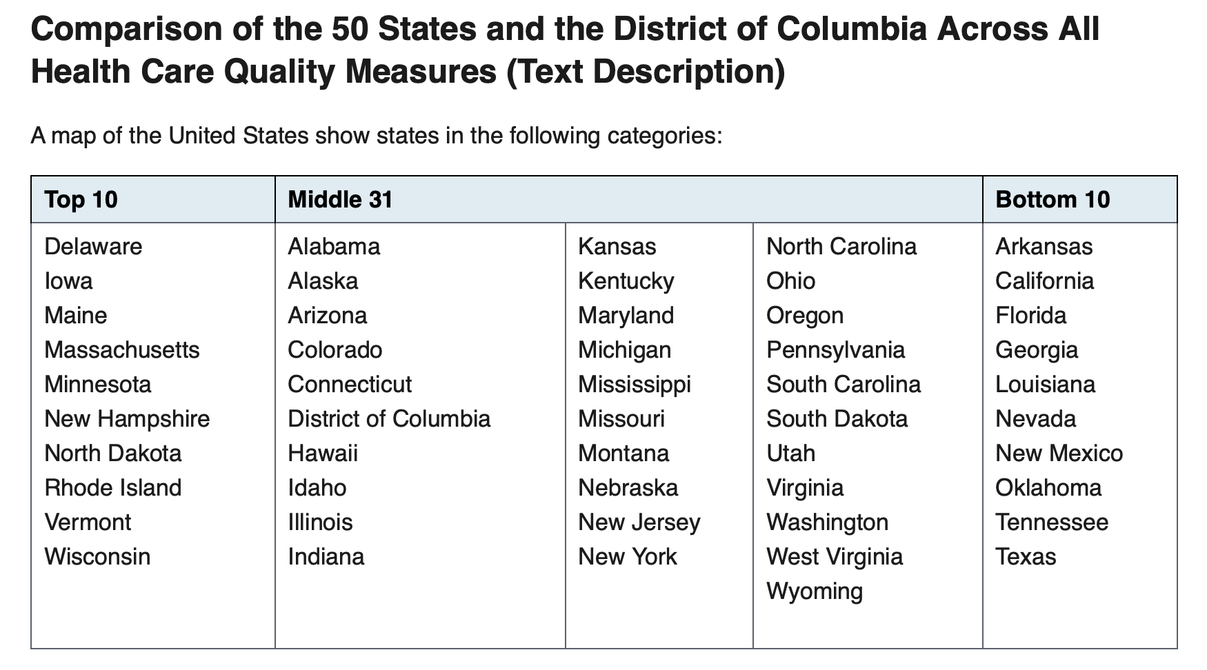
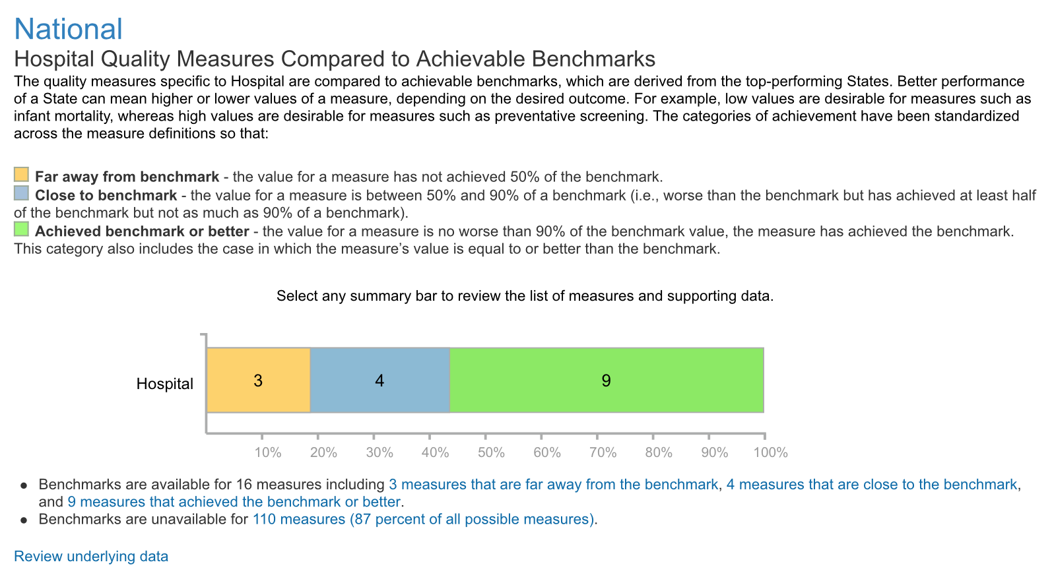
Health Care Quality

Slide 16
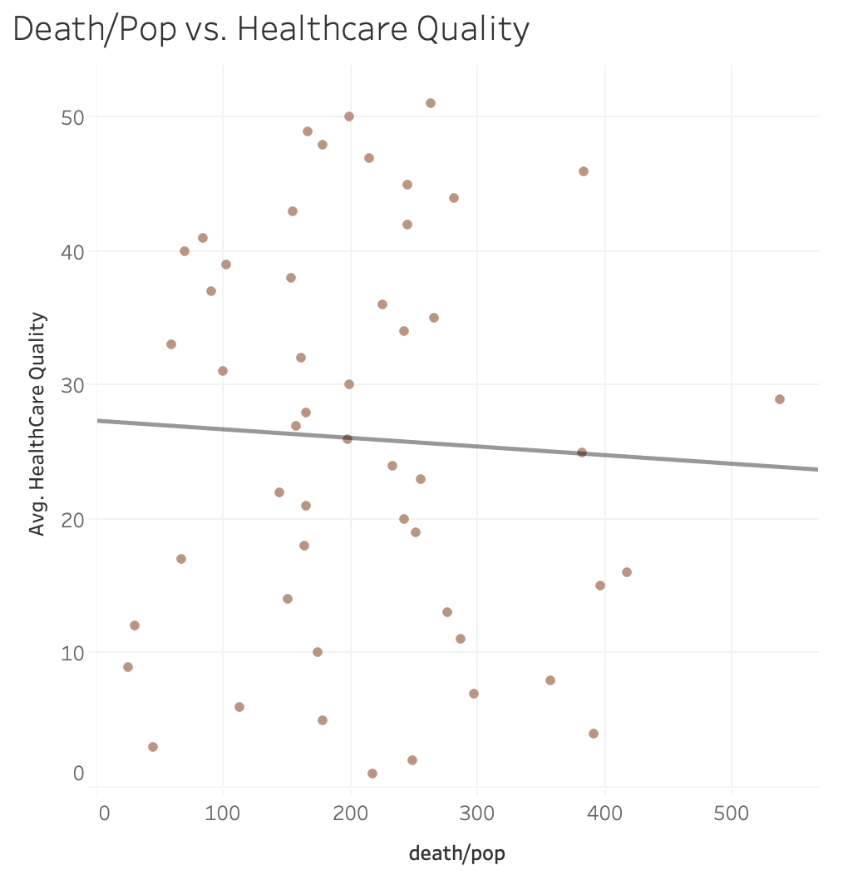
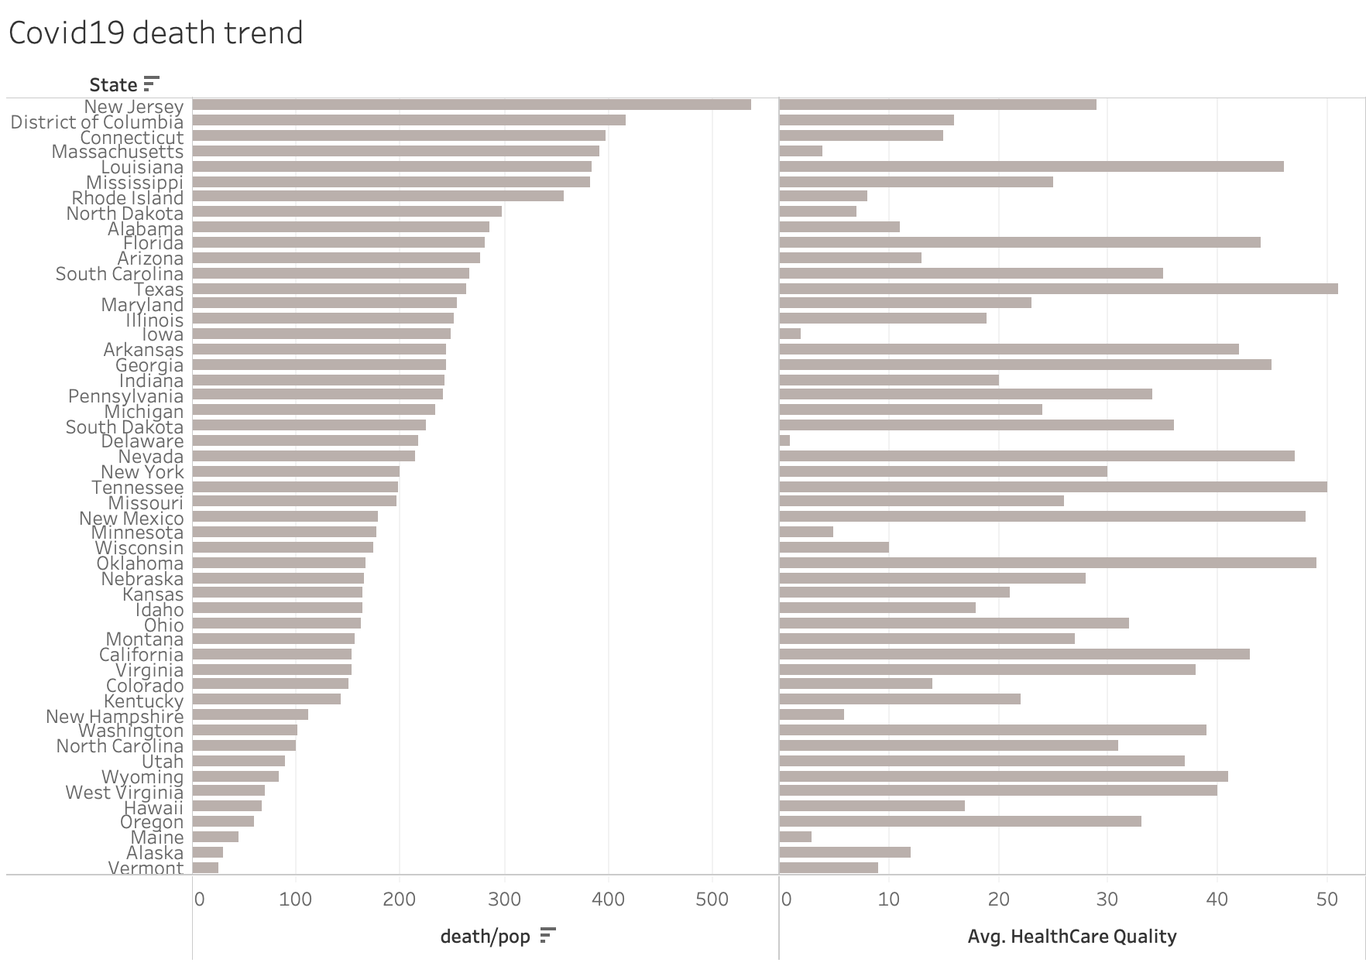

Slide 17

Demographic difference

Slide 18

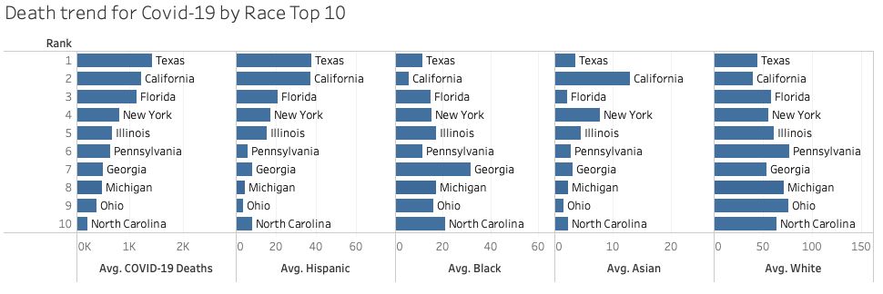
Covid-19 Death by Race

Slide 19
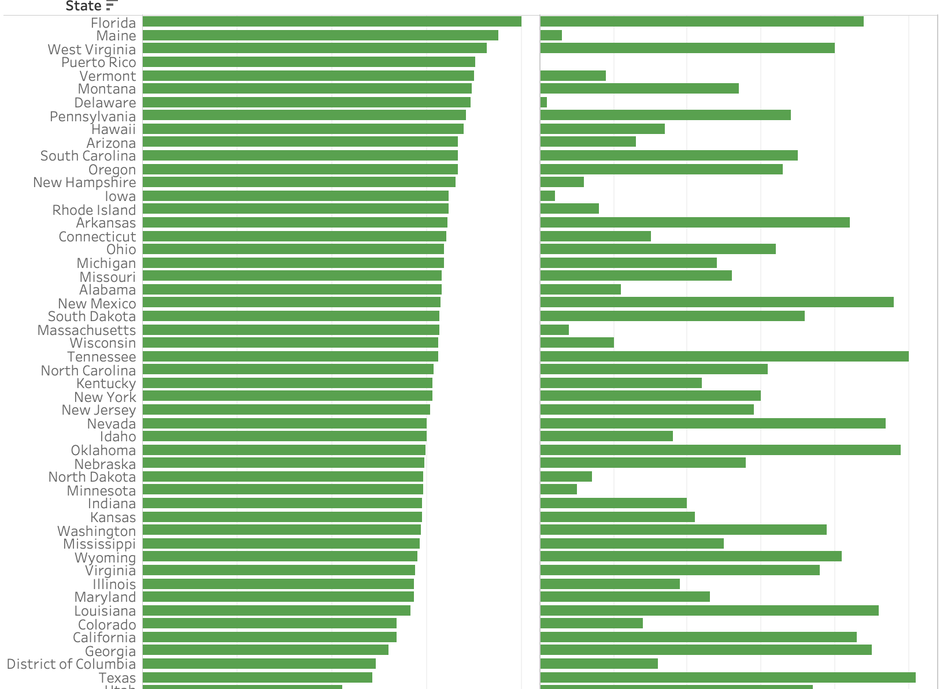
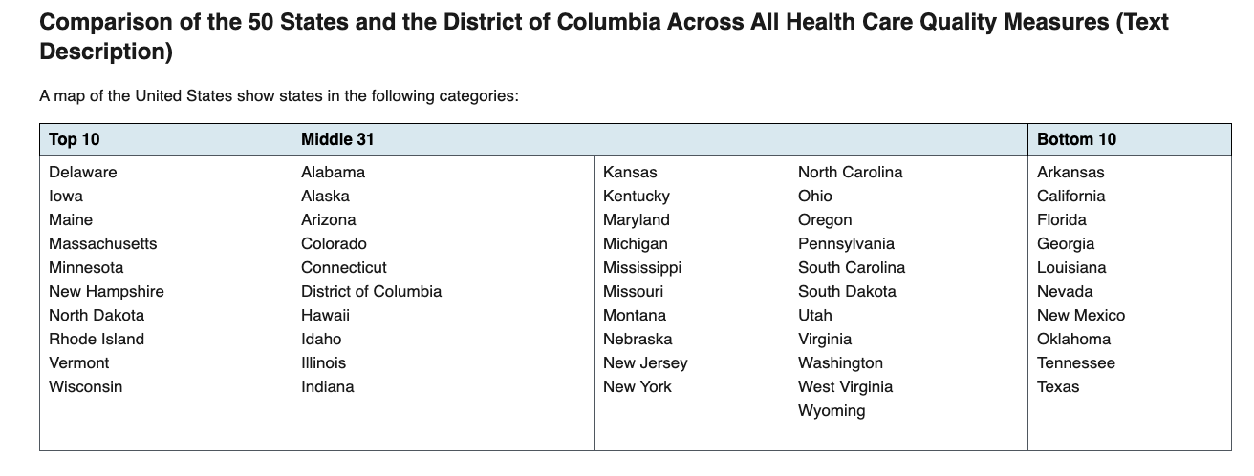

Seniors living in states w/ poor healthcare Quality? If so, Why? Pre-Existing condition Living in senior Homes (super spreader)

Slide 20

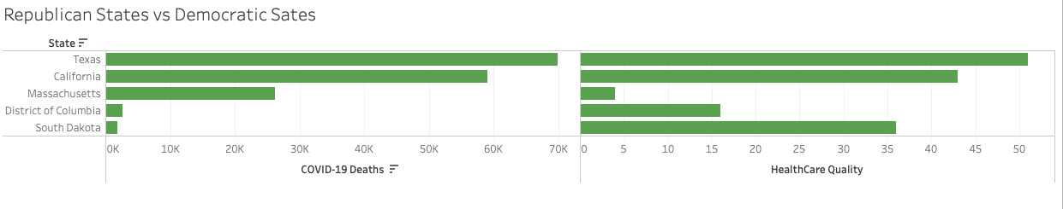
Republican states vs. Democratic States

Slide 21

The data provided with different parameter. The answer was unclear because the data was changing so fast. The Data was Inconclusive in some respects. Could AI with BI best describe Covid-19 better in the future?

Slide 22

Q & A

Slide 23
Reference(s)
https://www.kaggle.com/muonneutrino/us-census-demographic-data/activity
https://healthdata.gov/dataset/provisional-death-counts-coronavirus-disease-covid-19
https://www.ahrq.gov/data/infographics/state-compare-text.html

Slide 24
